Slide 1

Import Trends in India
Economics Project-4 Group-2

Slide 2
What is import?
Imports are goods, services and products brought into a country and which were bought from another country. Along with exports, imports form the backbone of international trade.
The higher the value of imports entering a country, compared to the value of exports, the more negative that country's balance of trade becomes.

Slide 3
Importance of Import
However, imports per se are not necessarily detrimental to economic performance, and in fact, are a vital component of the economy. A high level of imports indicates robust domestic demand and a growing economy. It’s even better if these imports are mainly of productive assets like machinery and equipment, since they will improve productivity over the long run.
A healthy economy, then, is one where both exports and imports are growing, since this typically indicates economic strength and a sustainable trade surplus or deficit.

Slide 4
Why import?
Countries are most likely to import goods that domestic industries cannot produce as efficiently or cheaply, but may also import raw materials or commodities that are not available within its borders.
For example, many countries have to import oil because they either cannot produce it domestically or cannot produce enough of it to meet demand

Slide 5
Why not Import Too much?
Most countries would prefer to import less, and export more. Countries that rely on imports for important commodities, such as food, oil, and industrial materials, are then dependent on other countries to keep their population fed and their manufacturers humming.
Countries with higher import levels then need to also increase their currency reserves to pay for the imports. In other words, a country would prefer to be a supplier to other countries.

Slide 6
Effect of foreign exchange on import
The exchange rate has an effect on the trade surplus (or deficit), which in turn affects the exchange rate, and so on. In general, however, a weaker domestic currency stimulates exports and makes imports more expensive. Conversely, a strong domestic currency hampers exports and makes imports cheaper.
Let’s use an example to illustrate this concept. Consider an electronic component priced at $10 in the U.S. that will be exported to India. Assume the exchange rate is 50 rupees to the U.S. dollar. Ignoring shipping and other transaction costs such as import duties for the moment, the $10 item would cost the Indian importer 500 rupees. Now, if the dollar strengthens against the Indian rupee to a level of 55, assuming that the U.S. exporter leaves the $10 price for the component unchanged, its price would increase to 550 rupees ($10 x 55) for the Indian importer. This may force the Indian importer to look for cheaper components from other locations. The 10% appreciation in the dollar versus the rupee has thus diminished the U.S. exporter’s competitiveness in the Indian market.

Slide 7
At the same time, consider a garment exporter in India whose primary market is the U.S. A shirt that the exporter sells for $10 in the U.S. market would fetch her 500 rupees when the export proceeds are received (again ignoring shipping and other costs), assuming an exchange rate of 50 rupees to the dollar. But if the rupee weakens to 55 versus the dollar, to receive the same amount of rupees (500), the exporter can now sell the shirt for $9.09. The 10% depreciation in the rupee versus the dollar has therefore improved the Indian exporter’s competitiveness in the U.S. market.
To summarize, a 10% appreciation of the dollar versus the rupee has rendered U.S.A exports of electronic components uncompetitive, but has made imported Indian shirts cheaper for U.S. consumers. The flip side of the coin is that a 10% depreciation of the rupee has improved the competitiveness of Indian garment exports, but has made imports of electronic components more expensive for Indian buyers.

Slide 8
Competitive Devaluation
Countries occasionally try to resolve their economic problems by resorting to methods that artificially depress their currencies in an effort to gain an advantage in international trade. One such technique is “competitive devaluation”, which refers to the strategic and large-scale depreciation of a domestic currency to boost export volumes.
Another method is to suppress the domestic currency and keep it at an abnormally low level. This is the route preferred by China, which held its yuan steady for a full decade from 1994 to 2004, and subsequently allowed it to appreciate only gradually against the U.S. dollar, despite having the world’s biggest trade surpluses and foreign exchange reserves for years.

Slide 9
Trade Deficit
Trade deficit is an economic measure of a negative balance of trade in which a country's imports exceeds its exports. A trade deficit represents an outflow of domestic currency to foreign markets.
Imports provide competition to domestic companies, who always want to sell more, whether its locally or overseas. They also receive a competitive advantage by exporting, because they learn and excel in producing a variety of globally-demanded goods and services. If a country imports more than it exports, it runs a trade deficit.

Slide 10
Trade Deficit (Contd.)
A long-term trade deficit leads to an unstable economy, where unemployment, foreign debt and currency crises become concerns.
Agriculture-based economies may face a trade deficit due to:
The seasonal nature of trade
Financial soundness of the domestic business, which significantly impacts the trade balance
Low domestic production or substandard quality goods downgrade the monetary value of imports
The overvaluation of the domestic currency may also lead to a long-term trade deficit. Static exchange rates and high inflation rates lead to the overvaluation of a currency.

Slide 11
Factors affecting Balance of trade
The cost of production (land, labor, capital, taxes, incentives etc.) in the exporting economy in exchange of those in the importing economy
The cost and availability of raw materials, intermediate goods and other inputs
Exchange rate movements
Multilateral, bilateral and unilateral taxes or restrictions on trade
Non-tariff barriers such as environmental, health or safety standards
The availability of adequate foreign exchange with which to pay for imports
Prices of goods manufactured at home (influenced by the responsiveness of supply)

Slide 12
India’s balance of trade
India had a favorable balance of trade only in 1972-72 (Rs. 104 Crore) and 1976-77 (Rs. 68 crore).
In today’s interlinked global economy, consumers are used to seeing products and produce from every corner of the world in their local malls and stores. These overseas products provide more choices to consumers and help them manage strained household budgets. But too many imports in relation to exports – which are products shipped from a country to foreign destinations – can distort a nation’s balance of trade and devalue its currency. The value of a currency, in turn, is one of the biggest determinants of a nation’s economic performance.

Slide 13
Why is india’s balance of trade unfavorable?
India has been incurring high expenses on Petroleum Bill. In 2006-07, India’s oil import bill was about US $ 48 billion. In 2007-08, it had gone up 40 percent, to US $ 68 billion. By way of comparison, the net invisibles surplus and the current account deficit were US $ 73 billion and US $ 17 billion (1.5 percent of GDP) in 2007-08, versus US $ 53 billion and US $ 10 billion (1.1 percent of GDP) in 2006-07. For the April-June quarter of 2008-09, oil imports grew by 50 percent to US $ 25 billion from US $ 17 billion in April-June 2007-08. This was at an average price of about US $ 118 a barrel, which is close to where the price settled today (August 5). This translates to US $ 100 billion a year. So, other things equal, that is another US $ 32 billion added to the current account deficit, or over 2 percent of GDP added to the current account deficit.

Slide 14
Trade Deficit

Slide 15
Balance of payment
Balance of Payment is defined as the 'flow of cash between domestic country and all other foreign countries'. It includes not only import and export of goods and services but also includes financial capital transfer.
BOP = BOT + (Net Earning on foreign investment i.e. payments made to foreign investors) + Cash Transfer + Capital Account +or - Balancing Item

Slide 16
Effect of import on economy
According to the expenditures method of calculating gross domestic product, an economy’s annual GDP is the sum total of C + I + G + (X – M), where C, I and G represent consumer spending, capital investment and government spending, respectively.
While all those terms are important in the context of an economy, let’s look closer at the term (X – M), which represents exports minus imports, or net exports. If exports exceed imports, the net exports figure would be positive, indicating that the nation has a trade surplus. If exports are less than imports, the net exports figure would be negative, and the nation has a trade deficit.

Slide 17
Countries from which India imports
Top 5 countries from which India imports maximum needed commodities
China (60413 million USD) (10.7% of total imports)
Saudi Arabia (28107 million USD) (8% of total imports)
United Arab Emirates (26139 million USD) (7% of total imports)
Switzerland (22133 million USD) (7% of total imports)
United States (21814 million USD) (5% of total imports)

Slide 18
India’s Import Trends
India's top 5 import items (as of 2016) are:
Petroleum crude (26.8% of total imports)
Gems and Precious Stones (15.3% of total imports)
Electronic goods (9.2% of total imports)
Machinery (8.2% of total imports)
Organic Chemicals (4.1% of total imports)

Slide 19
India’s stand on importing (2013)
3rd largest crude oil importer (9.3%) after US (17%) and China (14%).
2nd largest gold importer (15%) after Hong Kong (38%).
3rd largest coal importer (13%) after Japan (20%) and China(20%).
4th largest diamonds and precious stones (8.3%) after China(40%) , US(14%) and Hong Kong(11%).
2nd largest aircraft importer (8.3%) after USA(39%).

Slide 27
Notes:
Mean: 66.22 Billion$

Slide 28
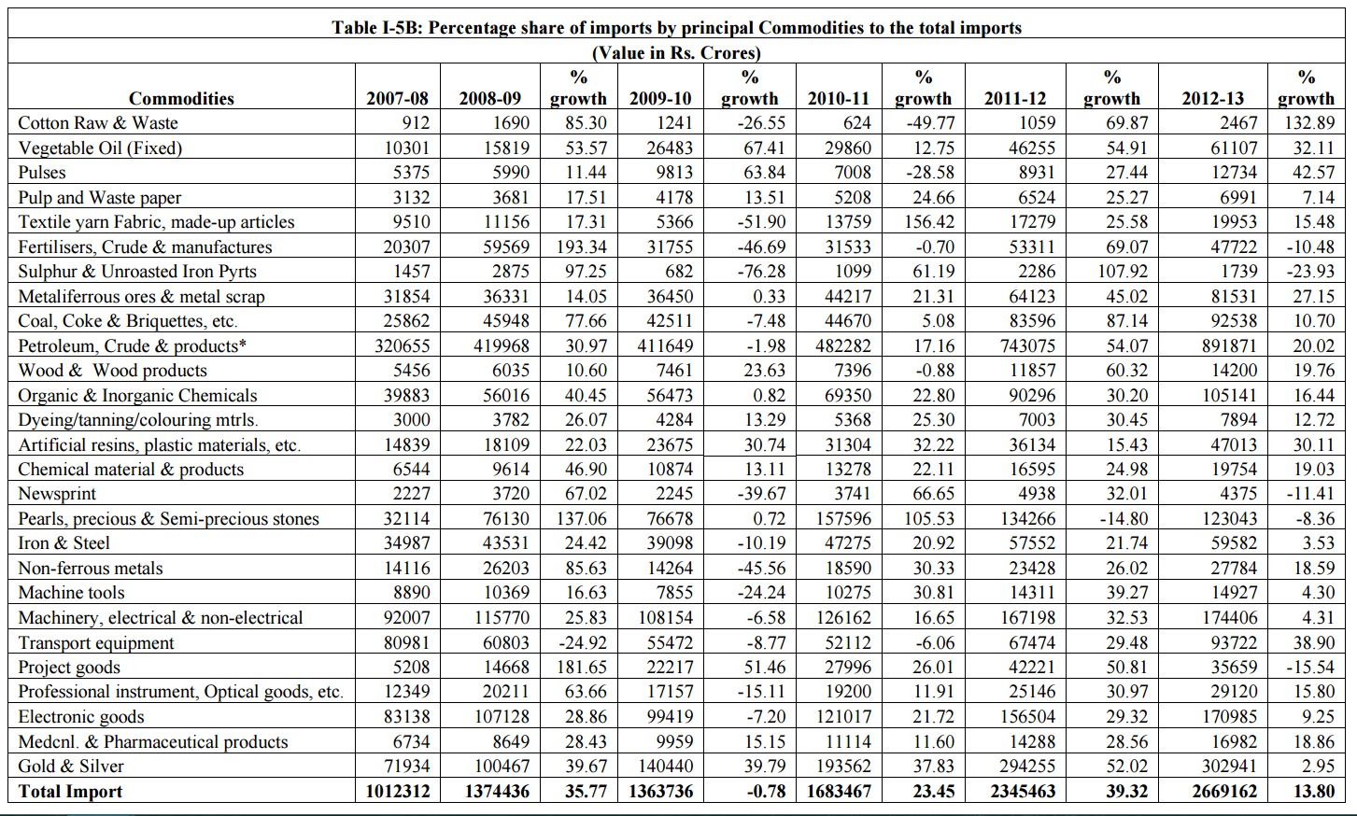

Slide 29
Group Members
Kaivalya Shah (1401108)
Ratnesh Shah (1401110)
Maitrey Mehta (1401040)
Jay Shah (1401053)
Aaditya Shah (1401107)
Ayam Ajmera (1401096)
Maharsh Patel (1401109)
Mohit Vachhani (1401073)

Slide 30
Thank You!

